Slide 1
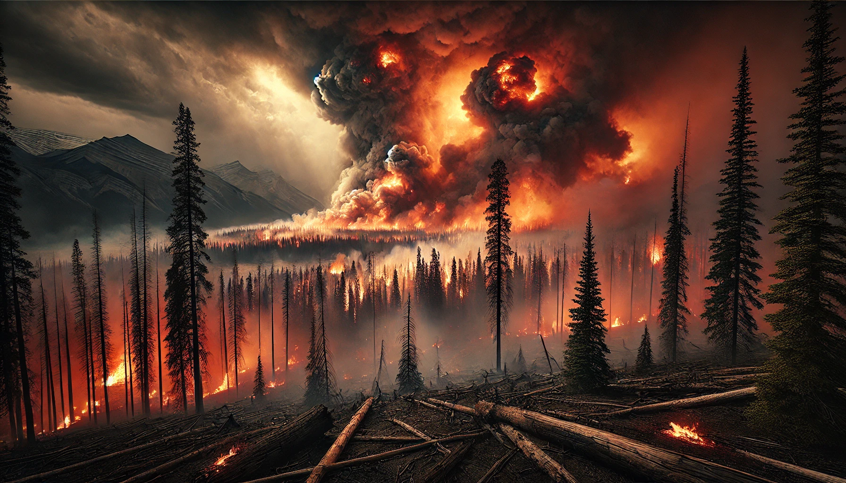
Applied ML Final Project
Initial Feasibility Report Presentation
Team Members

Slide 2
Agenda
Business Problem Statement
Responsible AI / Ethical Considerations
Project Goals
Data Context
Exploratory Data Analysis
Technical Approach
Conclusion & Next Steps

Slide 3
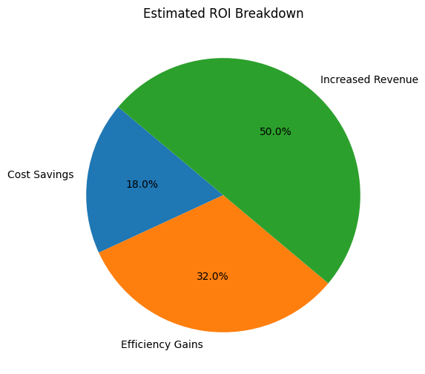
Business Problem Statement
Objective: Predict wildfire risks using ML models
Example: Jasper wildfire 2024 – Impact: $880 million loss
Potential savings from early detection: 10-20% of damages.

Slide 4
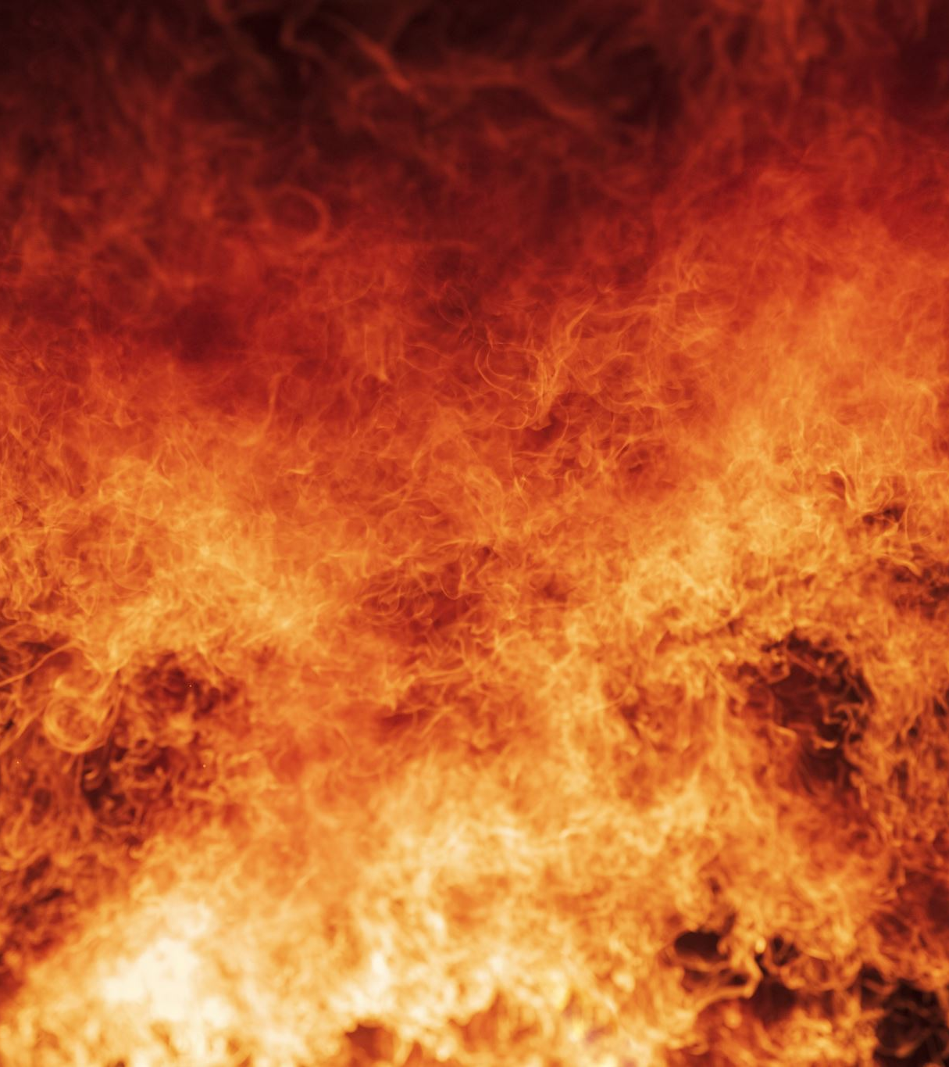
Why This Problem is Critical
Increasing frequency and severity of wildfires.
Societal, economic, and environmental impact.
Lack of early detection and prediction tools.

Slide 5

Responsible AI / Ethical Considerations
Bias & Fairness: Ensure balanced data across regions and ecosystems.
Privacy: Protect sensitive geospatial data.
Accountability: Validate predictions with expert oversight.
Transparency: Communicate model limitations and decision logic to communities.
Environmental Impact: Balance fire suppression with ecosystem health.

Slide 6

Project Goals & Benefits to Stakeholders
Goal 1: Predict wildfire risks.
Goal 2: Provide insights to emergency responders and policymakers.
Benefits:
Government: Improved decision-making.
Insurance: Reduced claims.
Communities: Enhanced safety and preparedness.

Slide 7

Data Context
Dataset 1: Wildfire historical data.
Dataset 2: Weather station data.
Dataset 3: Weather readings data.

Slide 8
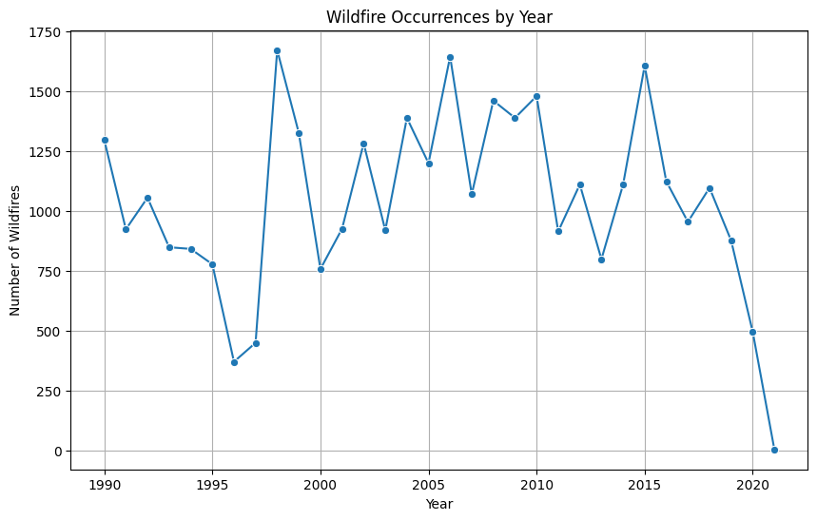
Overview of Datasets
Wildfire occurrences, weather readings, and environmental factors.

Slide 9
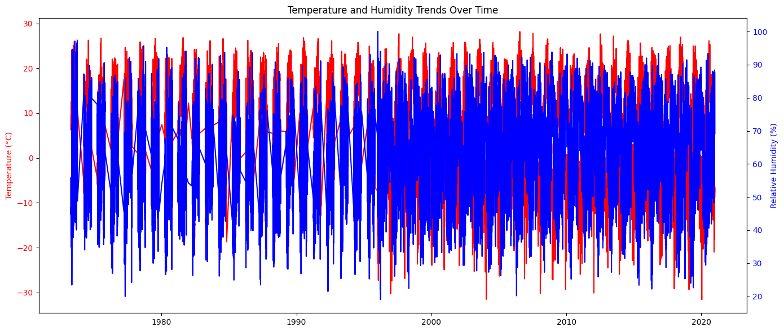
Exploratory Data Analysis (EDA)
Identify Patterns: To uncover trends in wildfire occurrences across different years and regions, providing insights into seasonal and regional risk factors.
Understand Key Drivers: Correlating weather conditions (e.g., temperature, humidity) with fire size enables us to identify critical environmental triggers.
Data Quality Check: To ensure data completeness and reliability, which is crucial for building accurate predictive models.

Slide 10

Proposed Technical Approach
Our wildfire prediction model employs a variety of techniques to capture complex environmental patterns and temporal dependencies. Linear regression serves as a baseline to understand fundamental trends. Random Forest and Gradient Boosting are applied for their ability to handle non-linear relationships and interactions among features, crucial for diverse wildfire data. Neural Networks, particularly Temporal Convolutional Networks (TCNs), are used to model time-series data, capturing seasonal and temporal shifts in wildfire risks. Support Vector Machines (SVM) provide an edge in identifying patterns and thresholds, while Ensemble Methods combine multiple models to enhance robustness and accuracy.

Slide 11

Techniques and Models:
Baseline Model: Linear Regression
Advanced Models: Random Forest, Gradient Boosting, Neural Networks
Additional Methods:
Support Vector Machines (SVM): For complex pattern detection.
Temporal Convolutional Networks (TCNs): To model time-series wildfire data.
Ensemble Methods: To aggregate multiple models and improve prediction accuracy.
K-Nearest Neighbors (KNN): For similarity-based predictions.
Recurrent Neural Networks (RNNs): To capture sequential dependencies in time-series data.

Slide 12
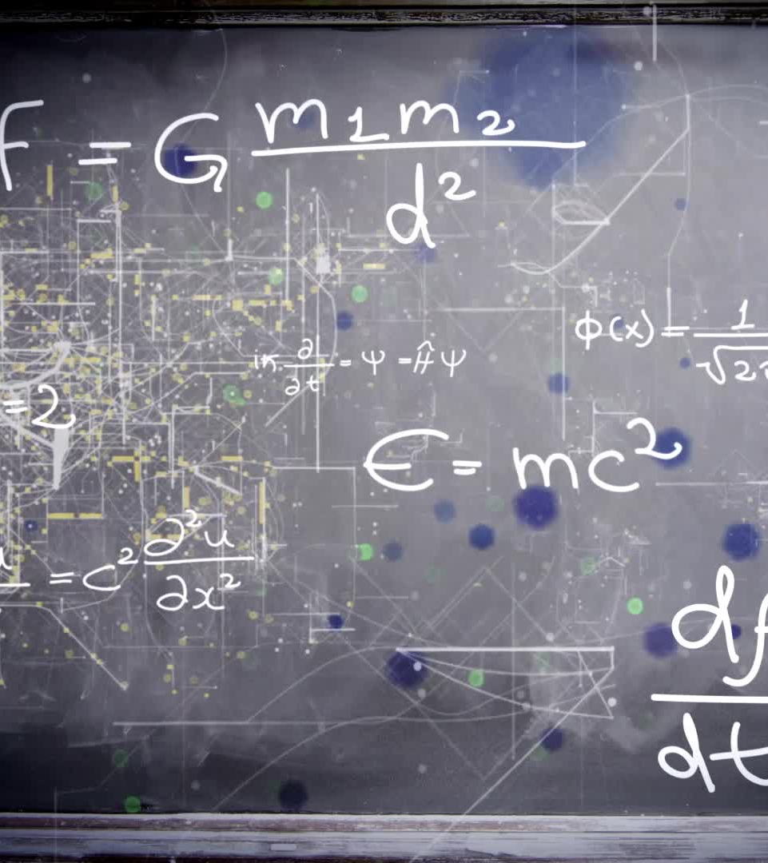
Feature Engineering
Rolling Averages: Smooths short-term weather trends (e.g., 7-day temp averages).
Cumulative Precipitation: Tracks moisture buildup, impacting fuel dryness.
Lagged Features: Captures influence of past conditions (e.g., 1-day lag).
Vegetation Indices: Reflects fuel availability for fires.
Interaction Terms: Models compounding effects (e.g., temp x wind speed).

Slide 13

Challenges in Data Modeling
Handling Missing Data: Incomplete records can impact model accuracy. Imputation or dropping strategies ensure data quality without losing essential information.
Balancing Underrepresented Regions/Periods: Some areas or time periods may have fewer data points, potentially biasing predictions. Techniques like resampling or synthetic data generation help create a balanced dataset for more reliable results.

Slide 14
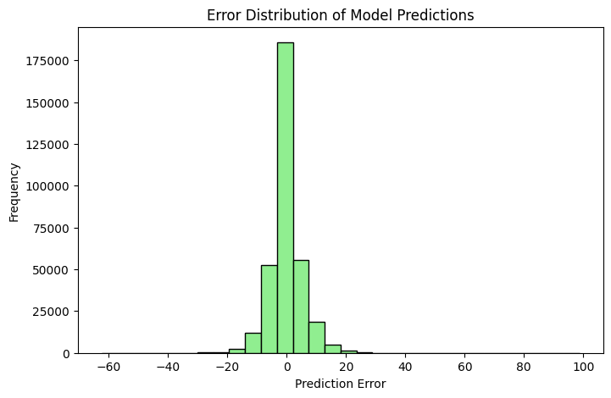
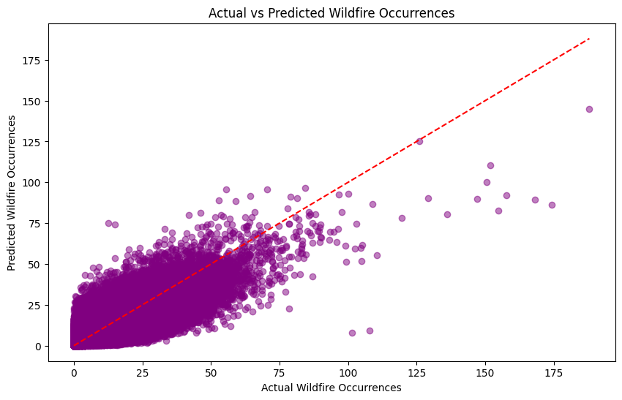
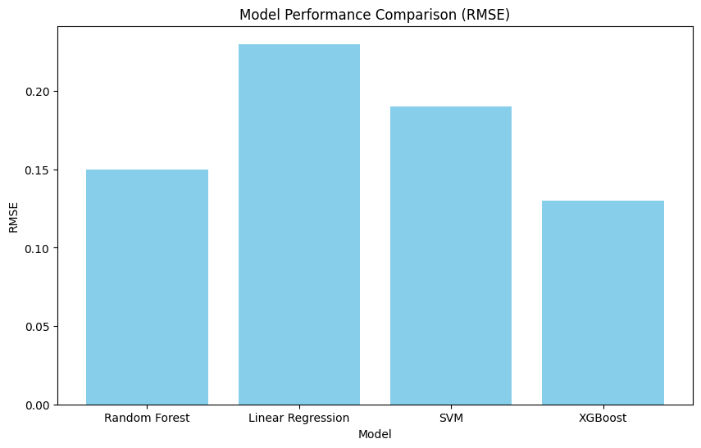
Model Performance and Prediction Accuracy

Slide 15
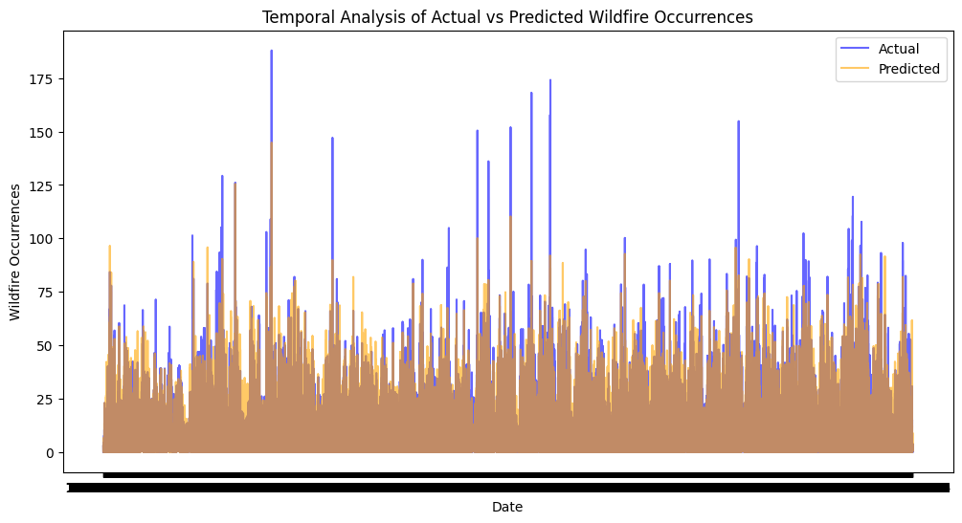
Temporal Analysis of Wildfire Predictions

Slide 16
Insights and Future Enhancements
Key Takeaways:
Model performance shows strong alignment between predicted and actual wildfire occurrences, as depicted in the comparative scatter and temporal analysis graphs.
Certain patterns in prediction errors suggest areas for further model refinement, particularly in high-frequency or high-severity instances.
Areas for Improvement:
Enhancing Model Accuracy: Further feature engineering and inclusion of additional environmental variables (e.g., humidity, vegetation density) could improve predictions.
Reducing Prediction Variability: By implementing techniques like ensemble models (e.g., XGBoost), the model may achieve more consistent predictions across diverse regions and conditions.

Slide 17

Proposed Project Outcomes and Next Steps
Projected Impact: This project aims to support wildfire risk mitigation through insights for emergency responders and policy guidance.
Future Research: Plans include exploring additional data sources and testing advanced machine learning models.
Project Timeline: A structured timeline with key milestones will be established to guide project progress.
Anticipated Challenges: We expect to address data gaps and balance representation in the dataset.
Long-term Goals: Enhance community preparedness and contribute to sustainable wildfire management solutions.

Slide 18

Thank You

